Slide 1





The Quick Gift Store Website
Student Name: Vedant Atul Simaria
Roll no: 193
Enrollment No: 21002170110185
Batch: A6 Branch: CE

Slide 2

Introduction:-
This is a Quick Gift Shop Website where you can find different types of gifts for any occation.
I have made this website using HTML and CSS.
In this I have used boostrap links like:-
<link rel="stylesheet“ href="https://cdn.jsdelivr.net/npm/@fortawesome/fontawesome- free@6.2.1/css/fontawesome.min.css" integrity="sha384- QYIZto+st3yW+o8+5OHfT6S482Zsvz2WfOzpFSXMF9zqeLcFV0/wlZpMtyFc ZALm" crossorigin="anonymous">

Slide 3
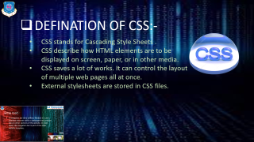
DEFINATION OF HTML:-
HTML stands for Hyper Text Markup language.
HTML is the standard markup language for creating Web pages.
HTML consists of a series of a web page.
HTML element tell the browser how to display the content.

Slide 4

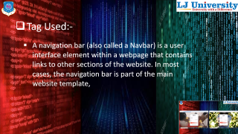
DEFINATION OF CSS:-
CSS stands for Cascading Style Sheets .
CSS describe how HTML elements are to be displayed on screen, paper, or in other media.
CSS saves a lot of works. It can control the layout of multiple web pages all at once.
External stylesheets are stored in CSS files.

Slide 5
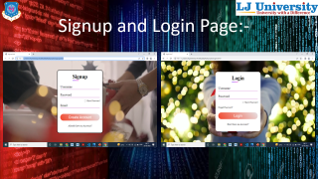
Tag Used:-
A navigation bar (also called a Navbar) is a user interface element within a webpage that contains links to other sections of the website. In most cases, the navigation bar is part of the main website template,

Slide 6
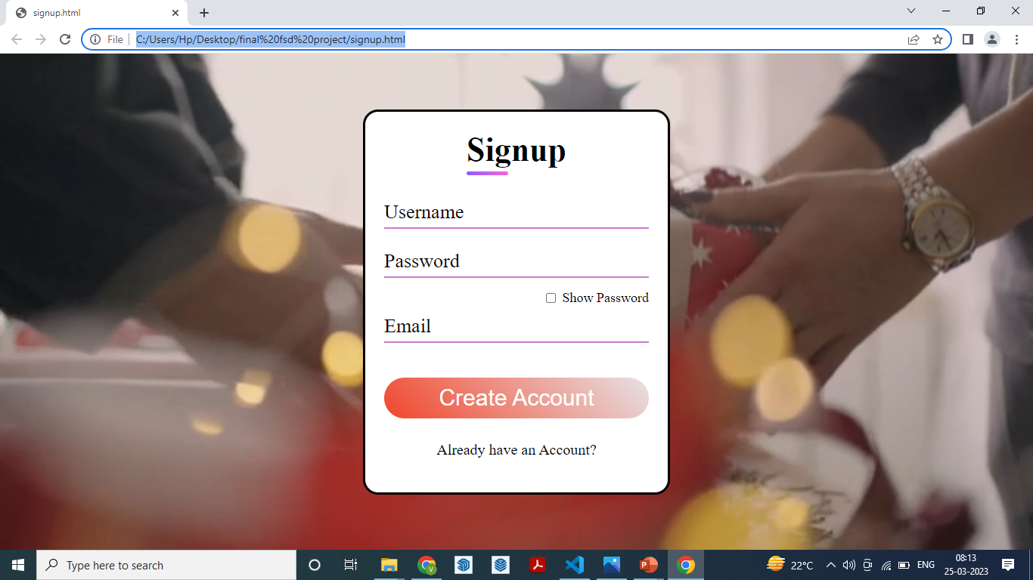
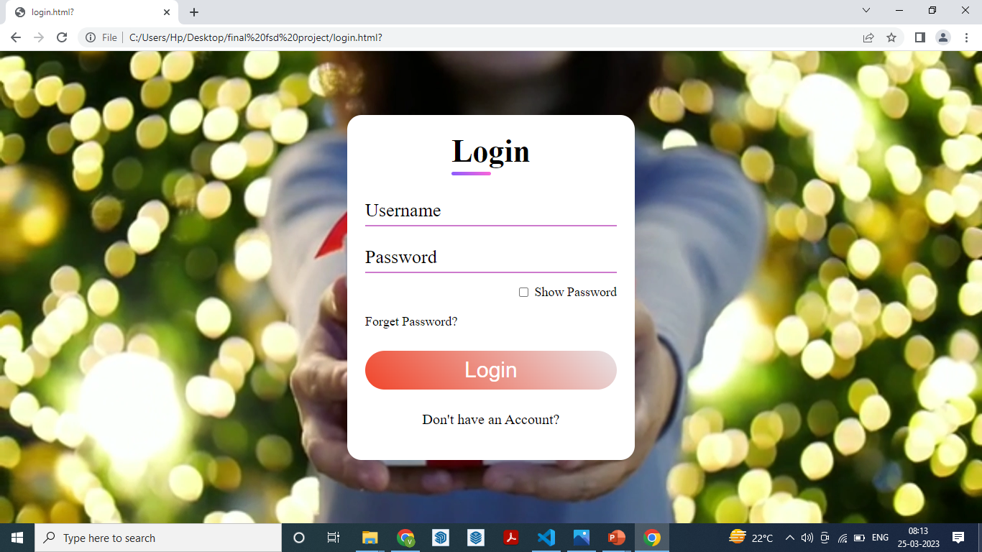
Signup and Login Page:-

Slide 7
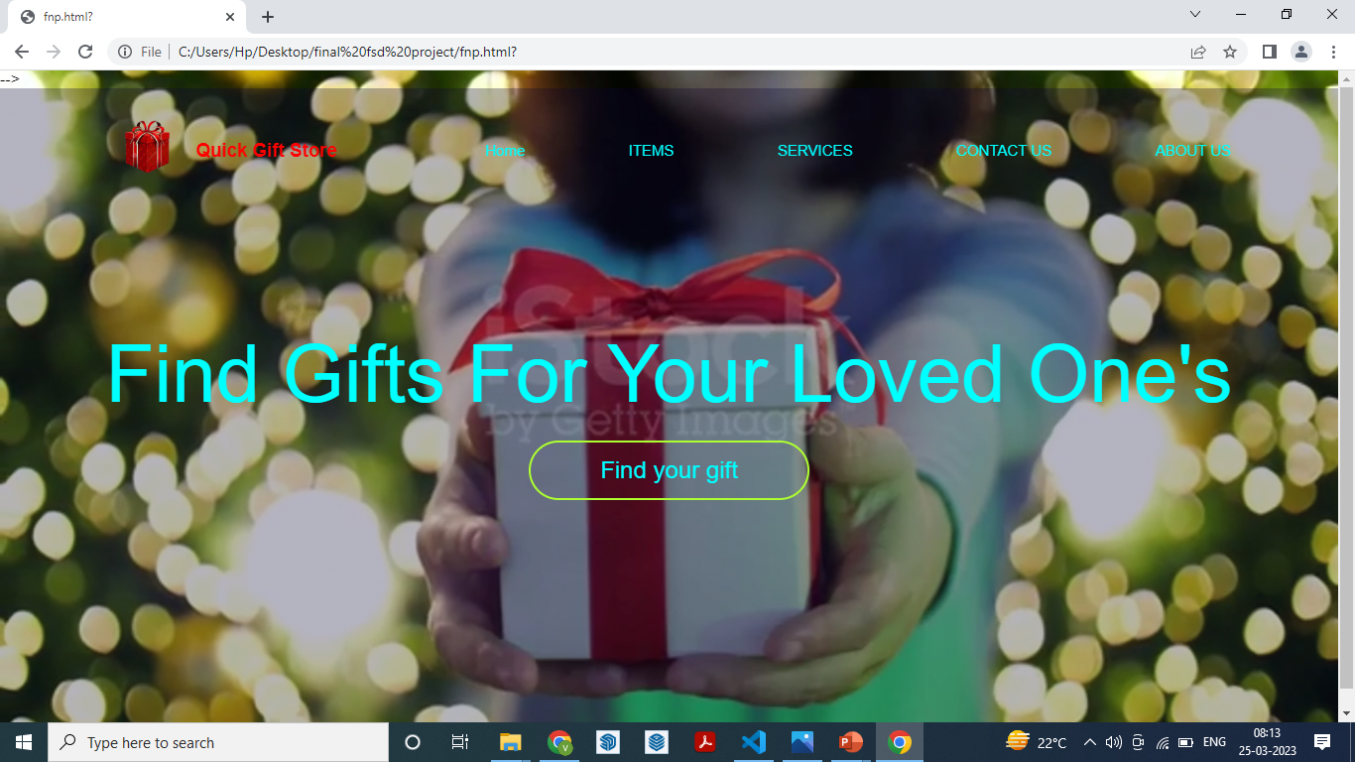
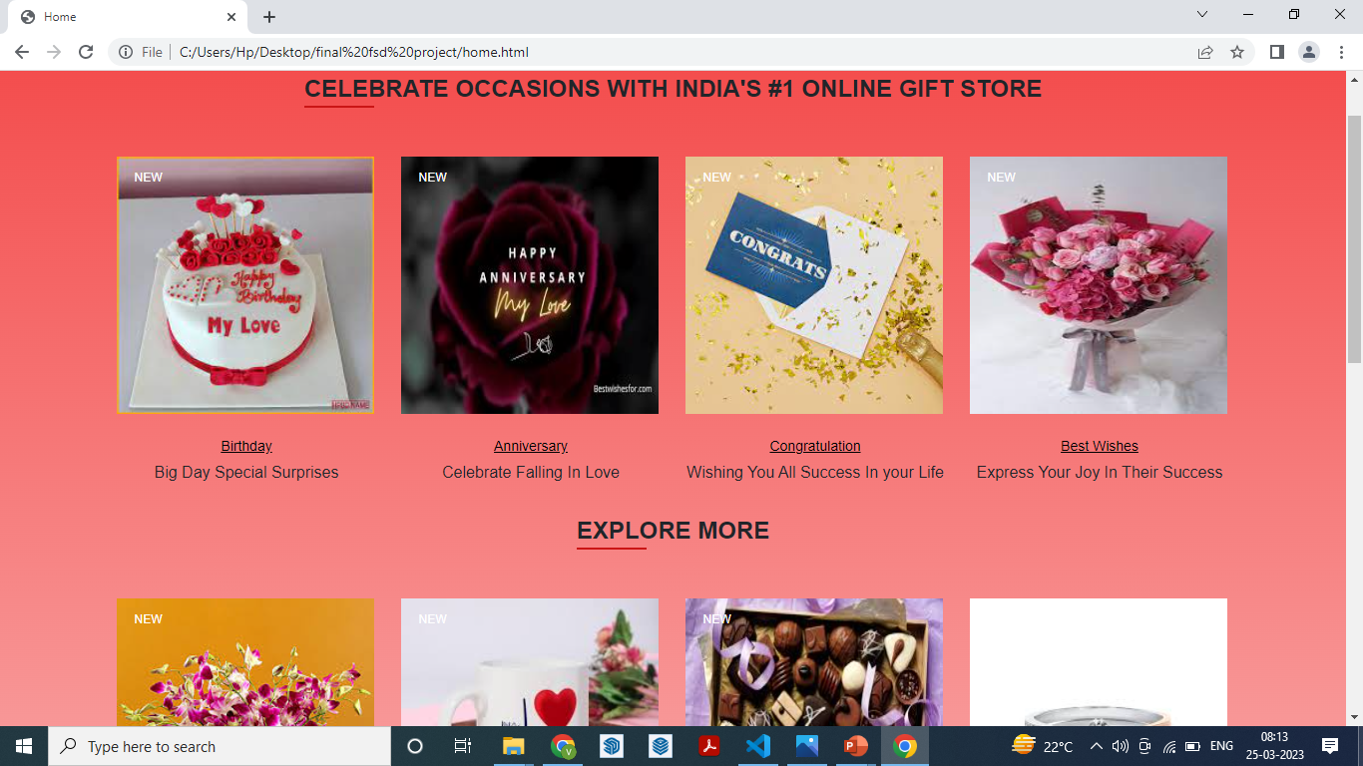
Main and Home page:-

Slide 8
THANK YOU

